Slide 1

AI and Existential Risk
Levan Bokeria
Presentation for the Foundational Models Discussion Group
2024-02-05

Slide 2
Foreword
Slides ~= endorsement
Postpone discussing people and institutes (like “the letter” and who signed it)
Discuss only the substance of AI x-risk:
Some of it!

Slide 3
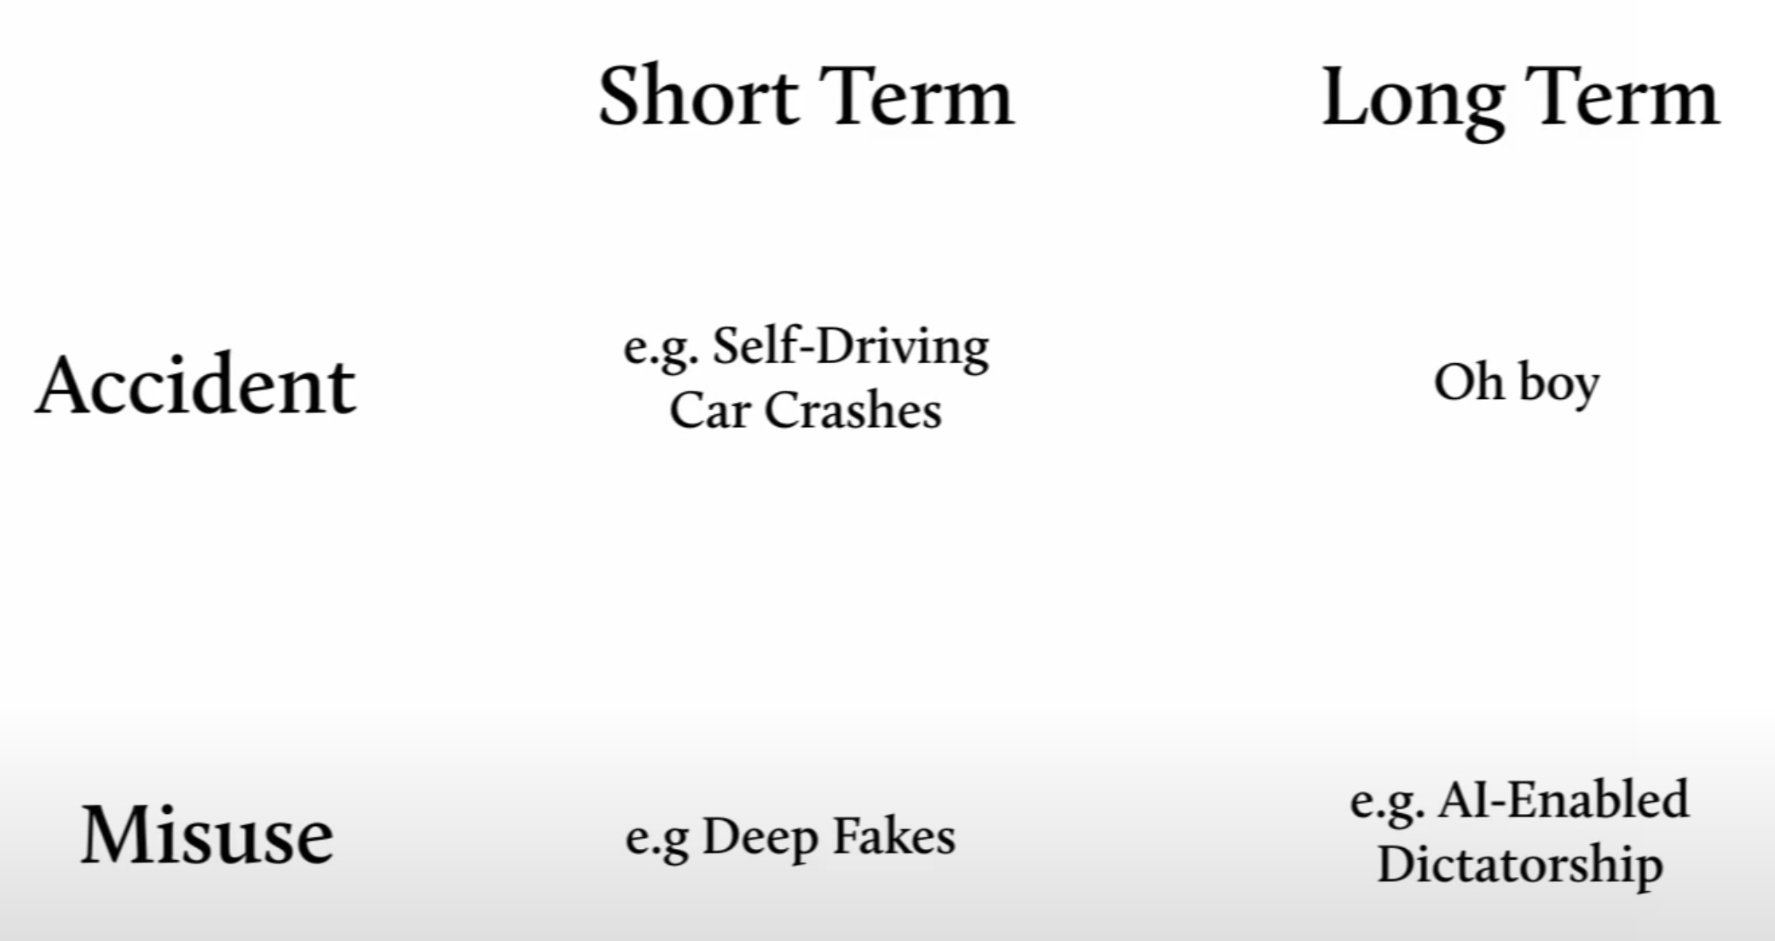
The AI Safety landscape:
Robert Miles, “Intro to AI Safety” https://www.youtube.com/watch?v=pYXy-A4siMw&t=604s

Slide 4
Definitions
X-risk:
“one where an adverse outcome would either annihilate Earth-originating intelligent life or permanently and drastically curtail its potential” (Bostrom 2002).
Artificial General Intelligence (AGI):
An AI system capable of solving tasks of at least as much generality as humans.
“highly autonomous systems that outperform humans at most economically valuable work” (cite, OpenAI: https://openai.com/charter )
Artificial Superintelligence (ASI):
”Any intellect that greatly exceeds cognitive performance of humans in virtually all domains of interest” (Bostrom, “Superintelligence”, 2014)
Intelligence:
Whatever it is that lets an agent choose effective actions to achieve its goals (Robert Miles, “Intro to AI Safety”)
Alignment:
An AI is “intent aligned” if it is trying to do, or “impact aligned” if it is succeeding in doing what a human person or institution wants it to do (Critch, 2020).
Notes:
[7] Bostrom, Nick “Existential Risks: Analyzing Human Extinction Scenarios and Related Hazards.” Journal of Evolution and Technology, Publisher's version, vol. 9, Institute for Ethics and Emerging Technologies, 2002.
‘HLMI’ was defined as follows:
The following questions ask about ‘high–level machine intelligence’ (HLMI). Say we have ‘high-level machine intelligence’ when unaided machines can accomplish every task better and more cheaply than human workers. Ignore aspects of tasks for which being a human is intrinsically advantageous, e.g. being accepted as a jury member. Think feasibility, not adoption.
https://wiki.aiimpacts.org/doku.php?id=ai_timelines:predictions_of_human-level_ai_timelines:ai_timeline_surveys:2022_expert_survey_on_progress_in_ai

Slide 5

General outline of the (strongest) argument:
AGI is possible
AGI is coming soon
AGI alignment is very hard
Mis-aligned AGI is an x-risk
AGI x-risk should be the top priority now
We can do something
Arguments from Nick Bostrom’s “Superintelligence”
Paperclip maximizer!
Specification gaming
RLHF problems
Mesa-optimisers
How to prioritize? The ITN framework
Other risks:
Nuclear wars?
Pandemics?
Synthetic biology?
Extrapolating trends
Scaling hypothesis
Expert surveys
Technical alignment work
Governance solutions
Public outreach work
Strategic awareness

Slide 6
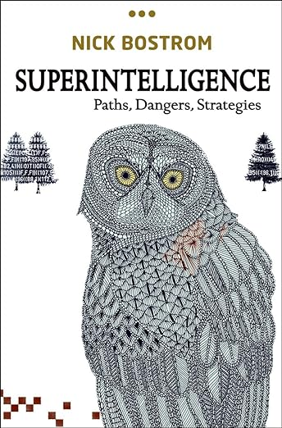
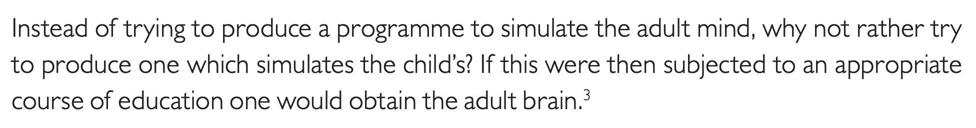
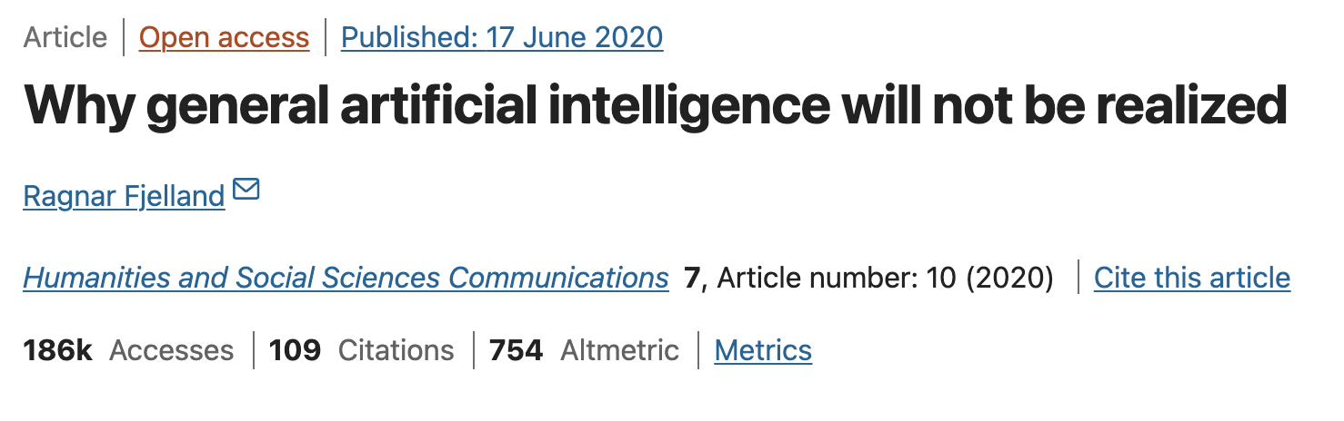
AGI is possible
Recapitulate evolution
Human brain as a template – whole brain emulation
Turing (1950) – A child machine:
Brain-Computer interfaces
Genetically engineer to higher biological abilities
Counterarguments:

Slide 7
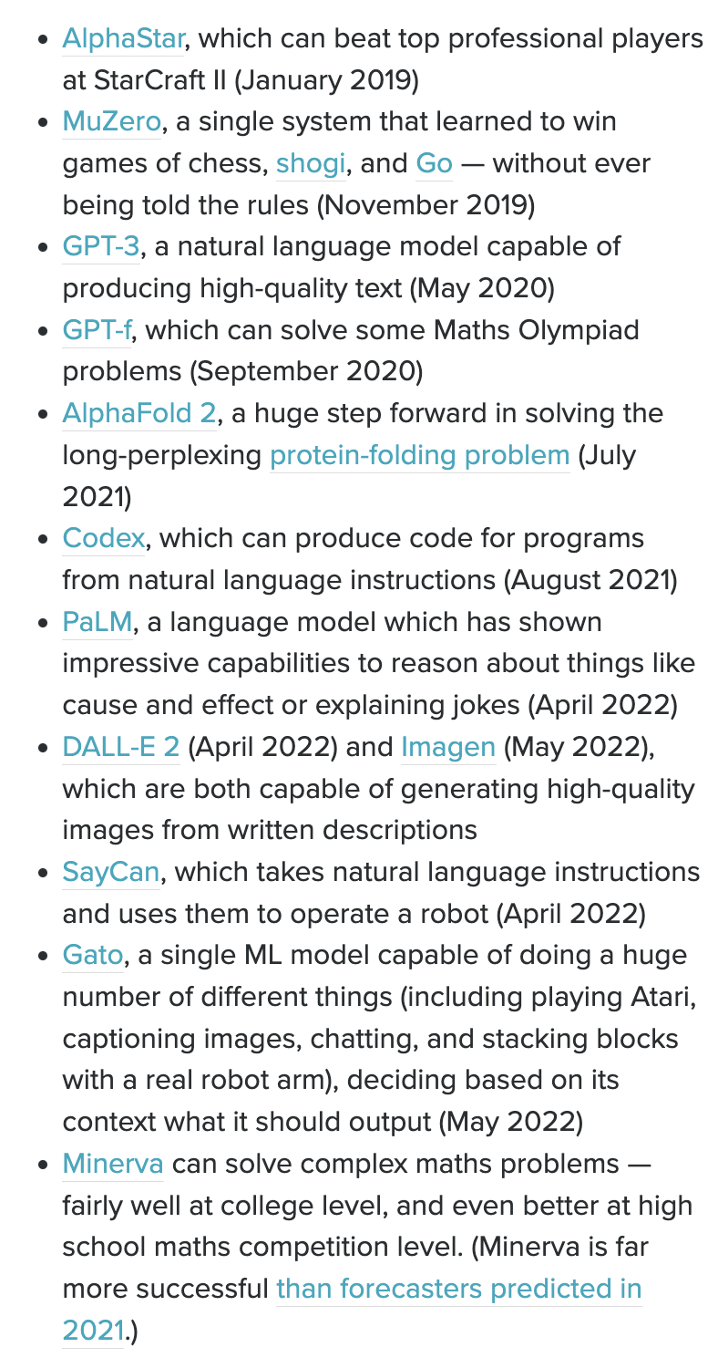
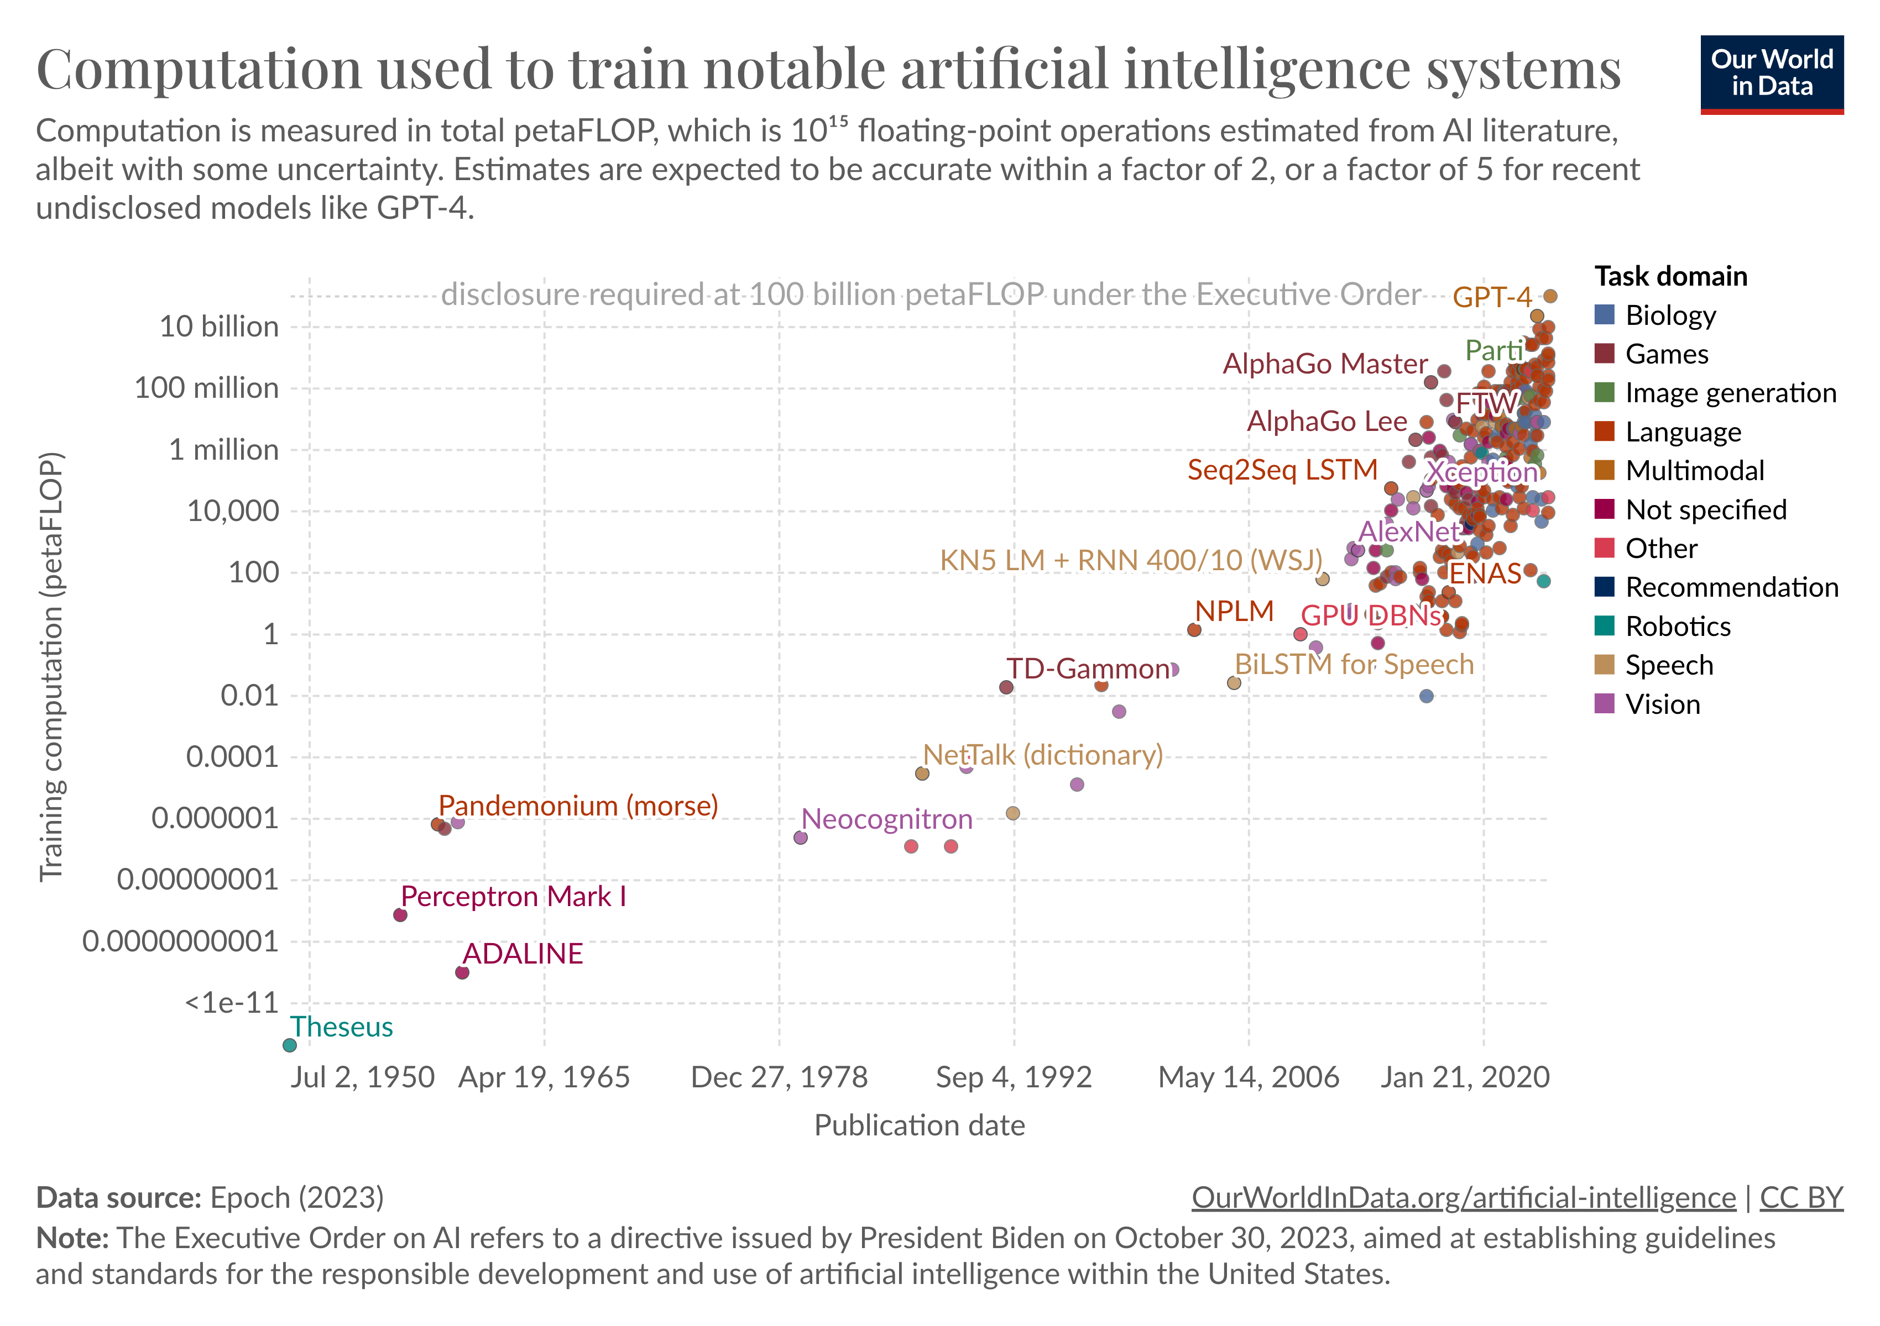
AGI is coming soon:
Deep learning explodes since mid-2010s.
AI/ML needs:
Algorithms
Data
Compute
Scaling hypothesis:
Computer vision: ImageNet
NLP: GPT-3
GPT 3.5, 4…
Bard
Llama
xAI?
Notes:
They found that, since 2012, the amount of compute used for training the largest AI models has been rising exponentially — doubling every 3.4 months.
That is to say, since 2012, the amount of computational power used to train our largest machine learning models has grown by over 1 billion times.
Hernandez and his team also looked at how much compute has been needed to train a neural network to have the same performance as AlexNet (an early image classification algorithm).
They found that the amount of compute required for the same performance has been falling exponentially — halving every 16 months.
Scaling hypothesis: (https://lastweekin.ai/p/the-ai-scaling-hypothesis) ” we can keep improving AI by just making things (amount of training data and/or the size of our neural nets) bigger, possibly all the way to achieve human-level or even superhuman AI”
“Based on this, Branwen coined the notion of the “scaling hypothesis”:
“The strong scaling hypothesis is that, once we find a scalable architecture like self-attention or convolutions, which like the brain can be applied fairly uniformly … we can simply train ever larger NNs and ever more sophisticated behavior will emerge naturally as the easiest way to optimize for all the tasks & data. More powerful NNs are ‘just’ scaled-up weak NNs, in much the same way that human brains look much like scaled-up primate brains⁠.”
”
Decision transformers – GATO
Skeptical: https://www.technologyreview.com/2020/08/22/1007539/gpt3-openai-language-generator-artificial-intelligence-ai-opinion/

Slide 8
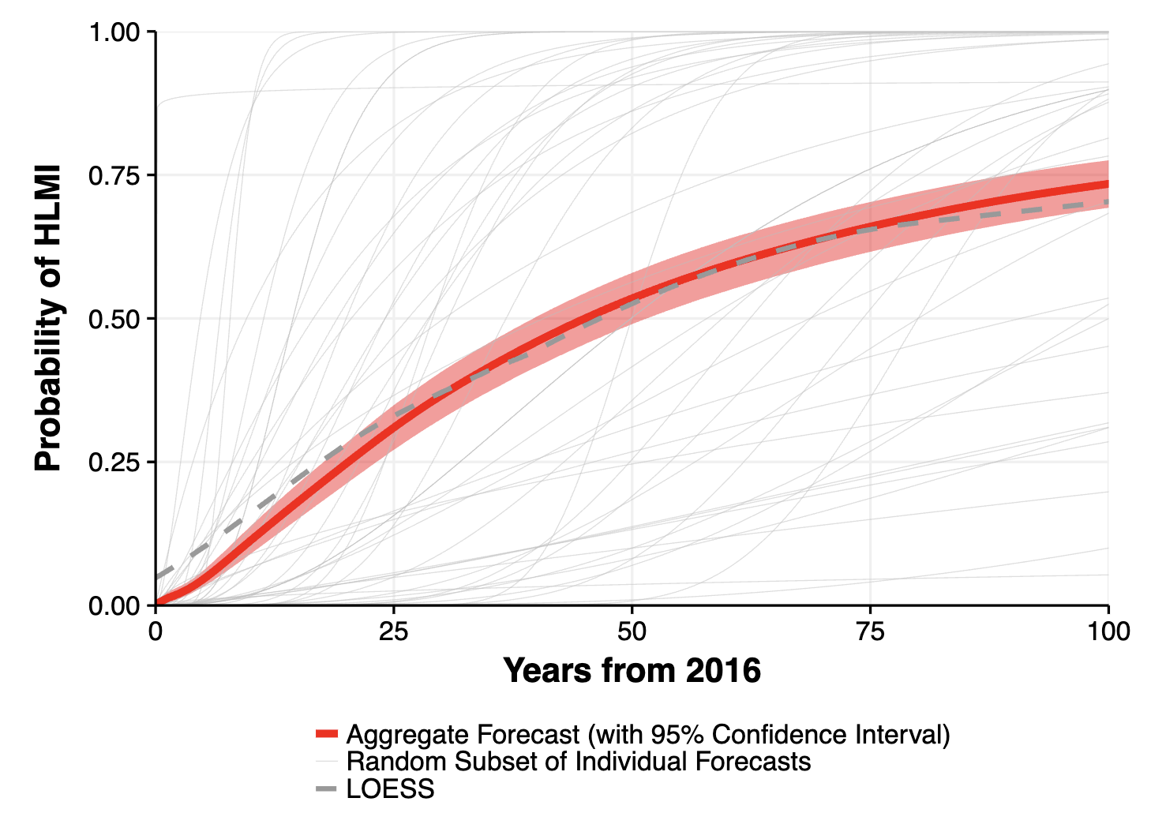
AGI coming soon
Expert surveys of authors in NeurIPS and ICML:
Median researcher estimate of “extremely bad (e.g. human extinction)” changes: 5% (2016), 2% (2019), 5% (2022)
Notes:
Katja Grace, who conducted the 2016 and 2022 surveys, notes on her blog that the framing of questions noticeably changes the answers given:
People consistently give later forecasts if you ask them for the probability in N years instead of the year that the probability is M. We saw this in the straightforward HLMI [high-level machine intelligence] question, and most of the tasks and occupations, and also in most of these things when we tested them on mturk people earlier. For HLMI for instance, if you ask when there will be a 50% chance of HLMI you get a median answer of 40 years, yet if you ask what the probability of HLMI is in 40 years, you get a median answer of 30%.

Slide 9

Alignment is hard
The paperclip maximizer
Giving a long list of “dos” and “don’ts” would not work.
Specification gaming
RLHF with superintelligence
Instrumental goals

Slide 10
Instrumental convergence hypothesis
“Instrumental convergence is the hypothetical tendency for most sufficiently intelligent beings (human and non-human) to pursue similar sub-goals, even if their ultimate goals are quite different.” (Wikipedia)
Self-preservation: “You can’t fetch coffee if you’re dead” – Stuart Russel.
Goal integrity: AGI will prevent us from changing its goal.
Power acquisition: for almost any purpose, having more power/resources will be useful.

Slide 11


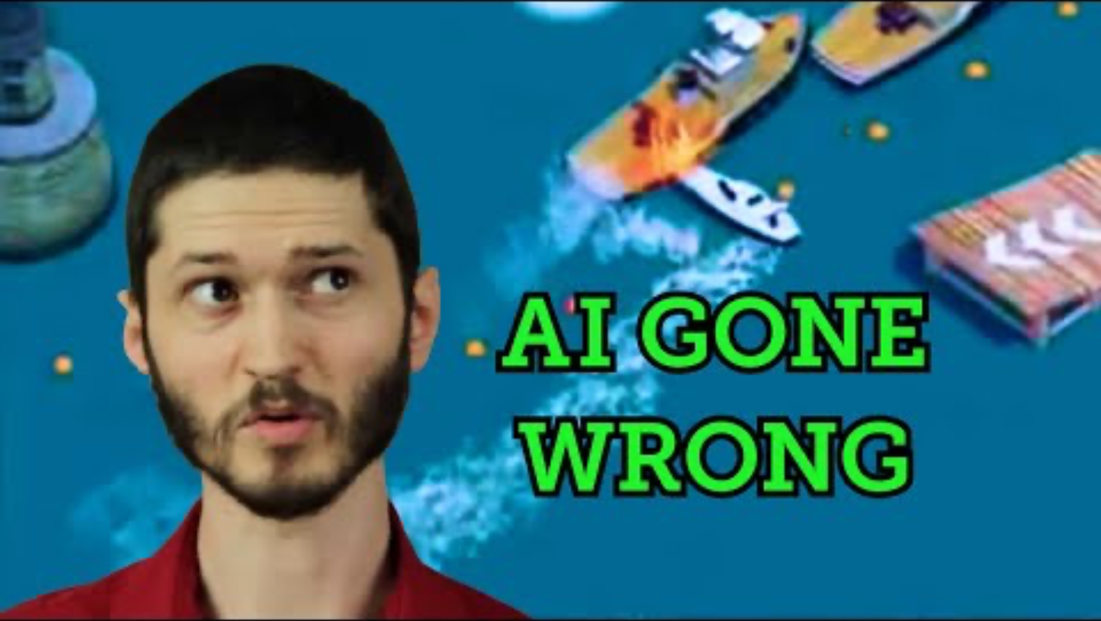
Specification gaming
Evolutionary algorithms
Reinforcement learning agents
Finding bugs
Victoria Krakovna blog: https://vkrakovna.wordpress.com/2018/04/02/specification-gaming-examples-in-ai/

Slide 12
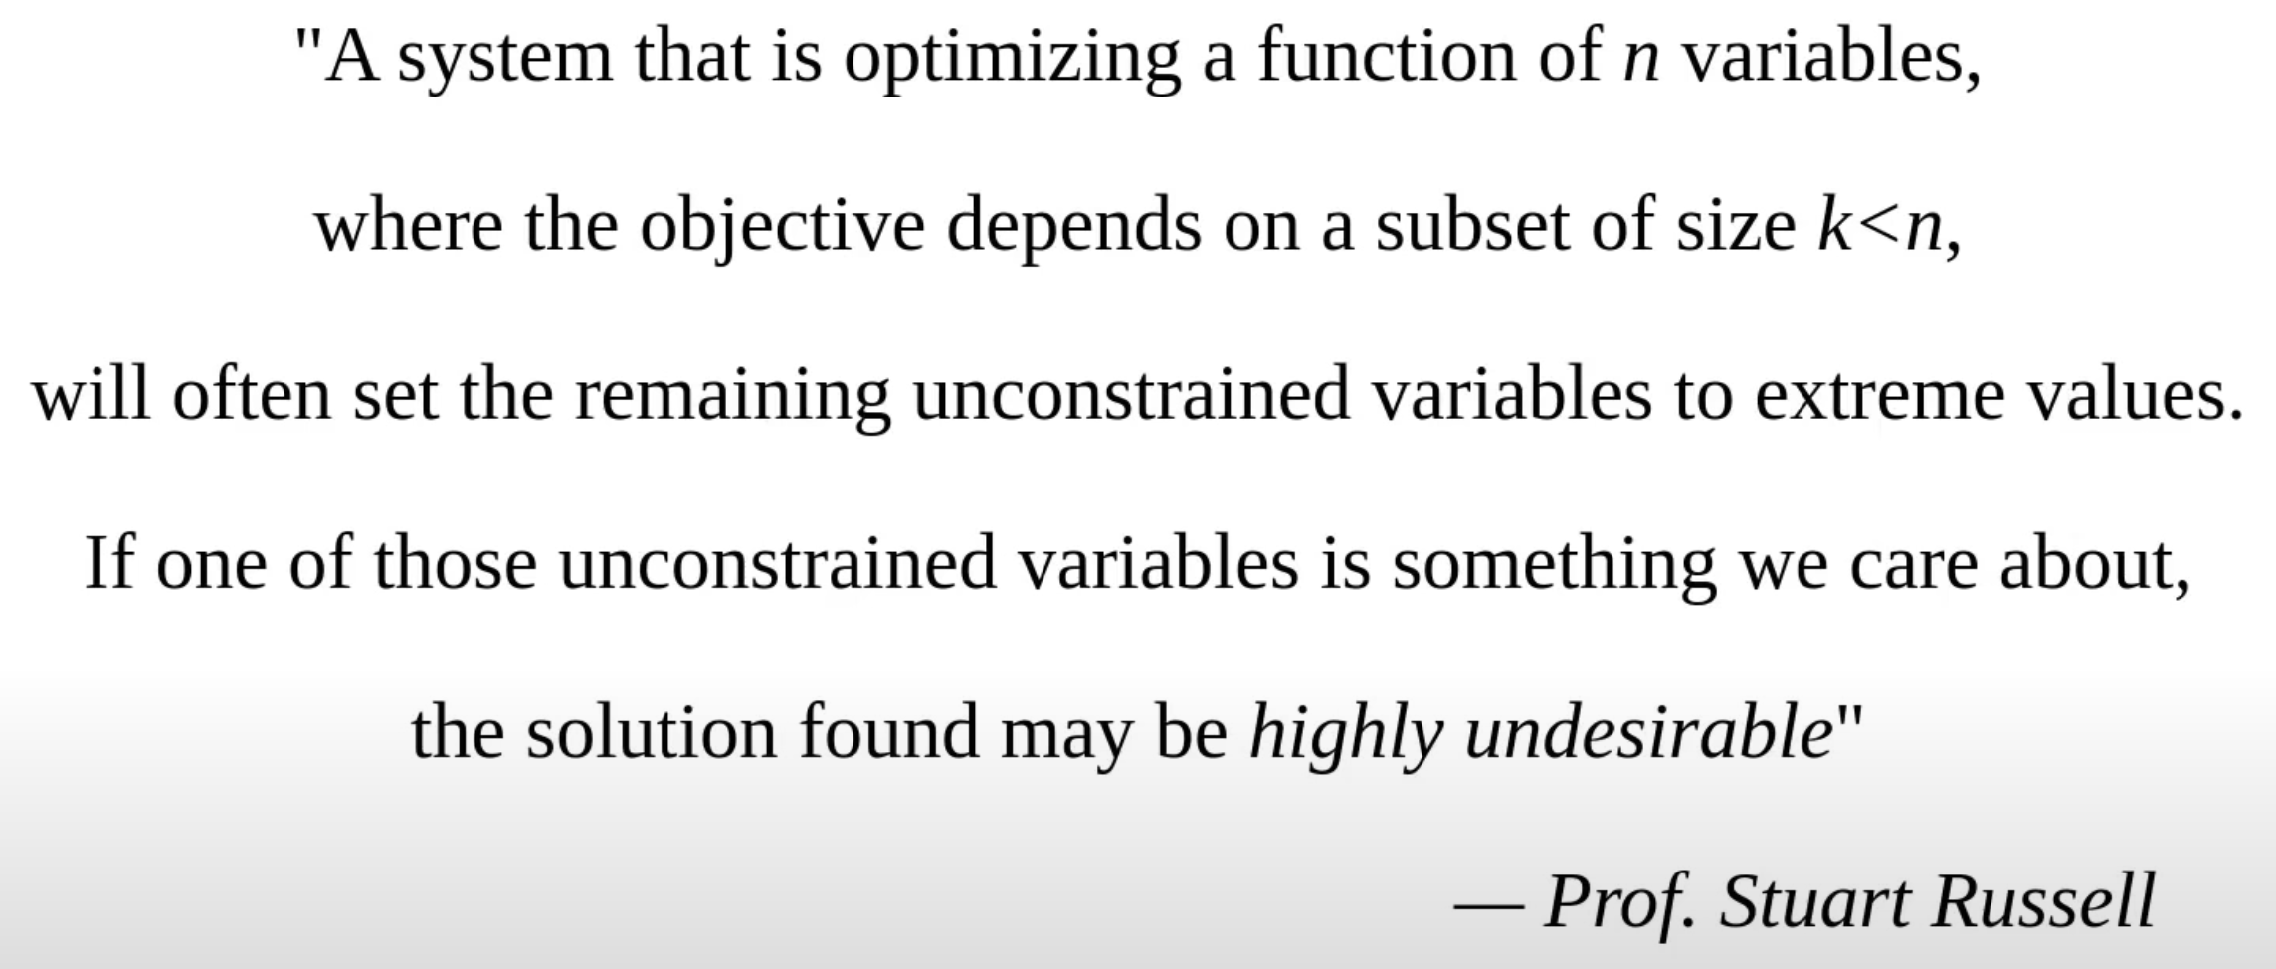
Specification gaming
Robert Miles, “Intro to AI Safety” https://www.youtube.com/watch?v=pYXy-A4siMw&t=604s

Slide 13
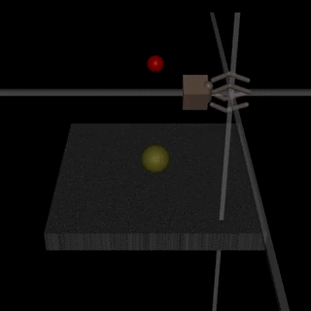
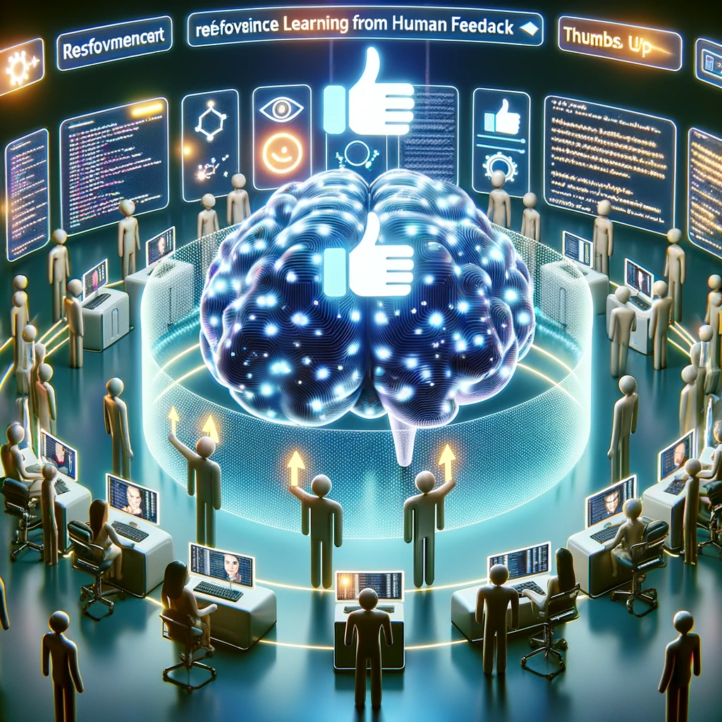
RLHF with superintelligence

Slide 14

Distributional shift

Slide 15
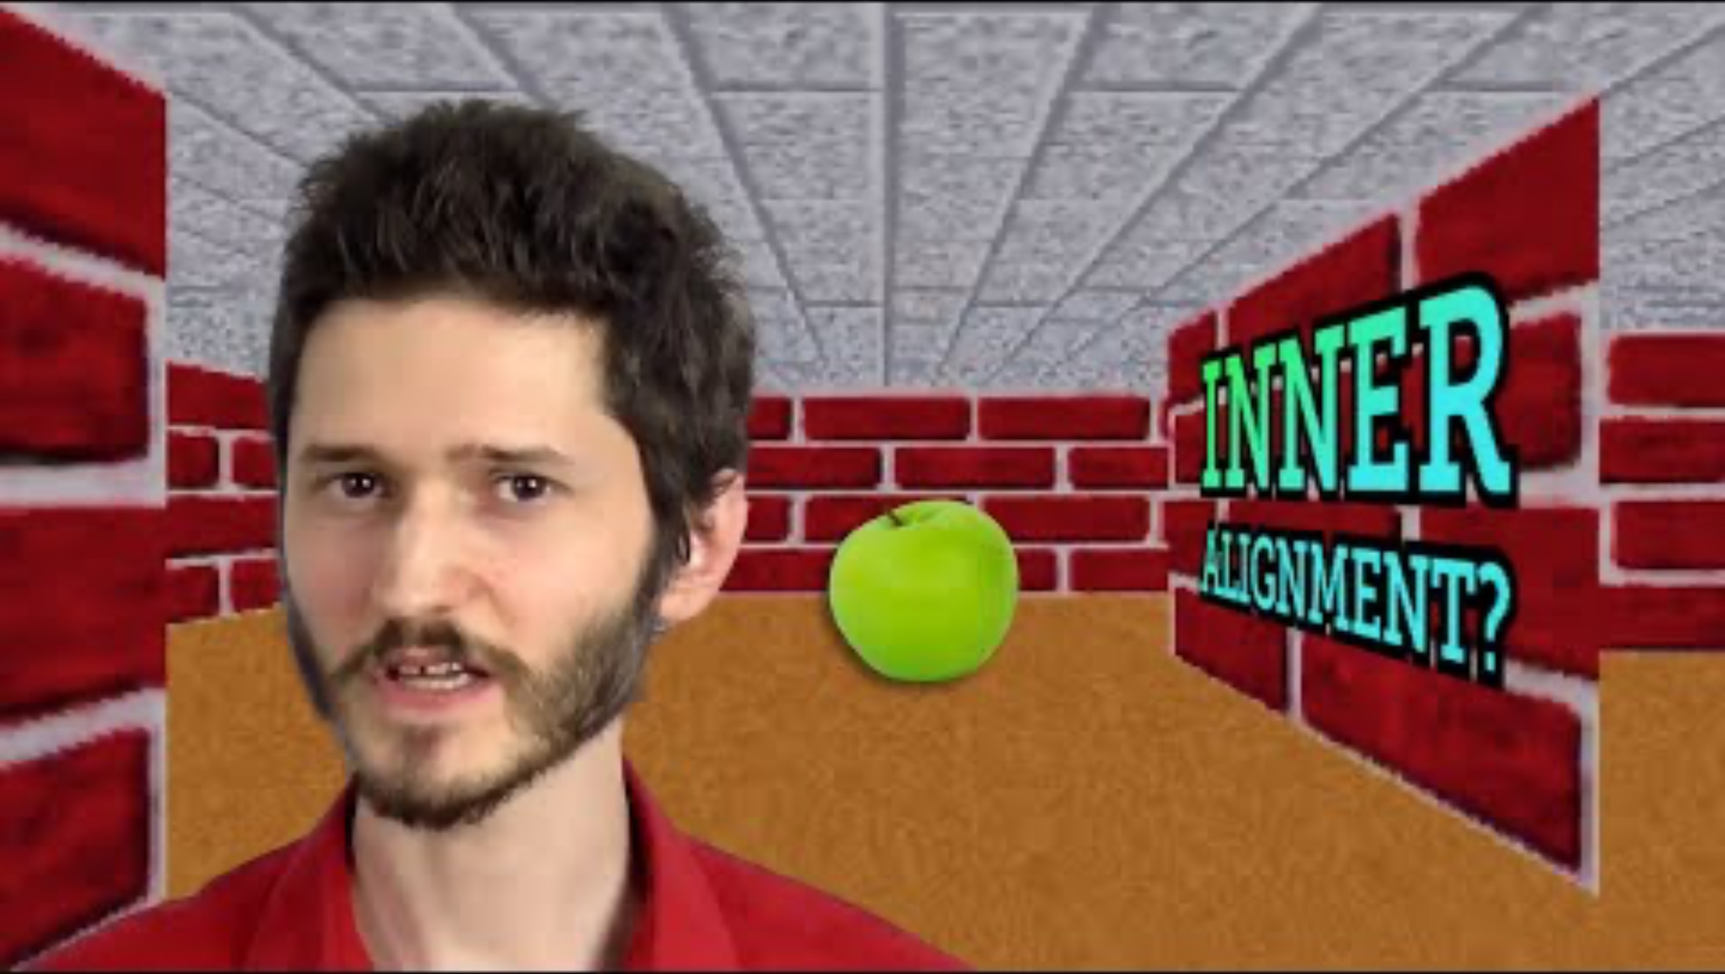
Mesa-Optimisers
Base
optimiser
Evolution
Humans
Mesa
optimiser
Humans
AI
Hubinger et al, 2021 https://arxiv.org/pdf/1906.01820.pdf

Slide 16

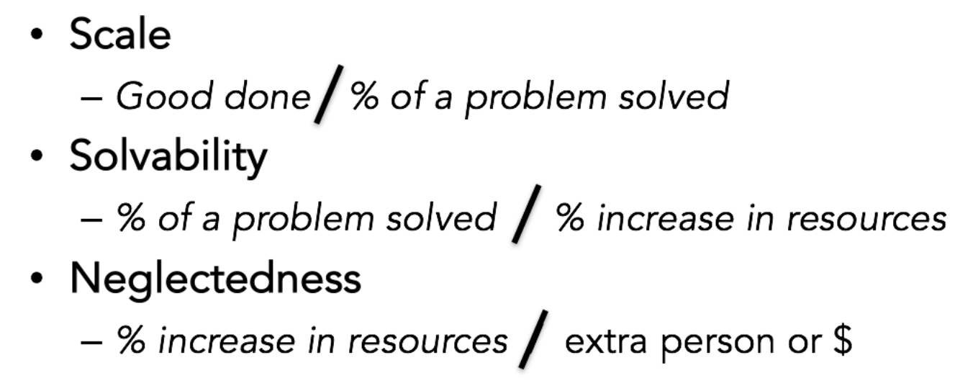

Is AI x risk a priority?
The ITN framework:
Importance
Tractability

Slide 17
What can we do about it?
Technical work on AI alignment
Inverse Reinforcement Learning (IRL)
Alignment through Debate
Iterated Distillation and Amplification (IDA)
Governance work
Public outreach and education

